Slide 1
BMW Sales and Global GDP: A Comparative Analysis
By Kelvin Rodriguez - IS362
Notes:
Hello everyone. The name of my project is "BMW Sales and Global GDP: A Comparative Analysis." I looked at BMW's sales around the world from 2010 to 2024 and compared them to global GDP growth to get a better idea of how the economy affects a company's performance.

Slide 2
Agenda
01
Proposal
03
Data Analysis
Introduction
Overview
Relationship Between BMW Sales and Global GDP Growth
Regression Analysis and Future Sales Forecasting
02
Data Presentation
04
Challenges
BMW Global Sales Trend (2010–2024)
Data
Global GDP Growth Trend (2010–2024)
Code
Notes:
This is the plan for today's presentation. I'll start by talking about the project's idea and why it was started. Then I'll show the data, analyze it, and make predictions about what will happen. I'll finish with a short conclusion and a list of the problems I had.

Slide 3
Proposal

Slide 4
Proposal / Introduction
What the project is about:
“Analyzing BMW’s global unit sales from 2010–2024 and examining how these trends relate to global GDP growth.”
Motivation:
  You are a BMW enthusiast
  Kaggle dataset had inaccuracies
  You collected and verified data from 14+ BMW annual reports
Data sources:
  Custom BMW dataset (created from official reports)
  World Bank API (global GDP growth)
Goal:
“Understand sales trends, economic relationships, and generate simple predictions for 2025–2030.”
Notes:
I choose this project because I love BMWs and wanted to learn more about how the brand's sales have changed over time. I started using a Kaggle dataset, although it had several mistakes in it. So, instead, I generated my own dataset by checking facts from more than fourteen BMW annual reports. I also got world GDP data from the World Bank API. The main purpose is to look at BMW's sales trends and see how they relate to the state of the world economy. Then, create simple projections for the next few years.

Slide 5
Data Presentation

Slide 6
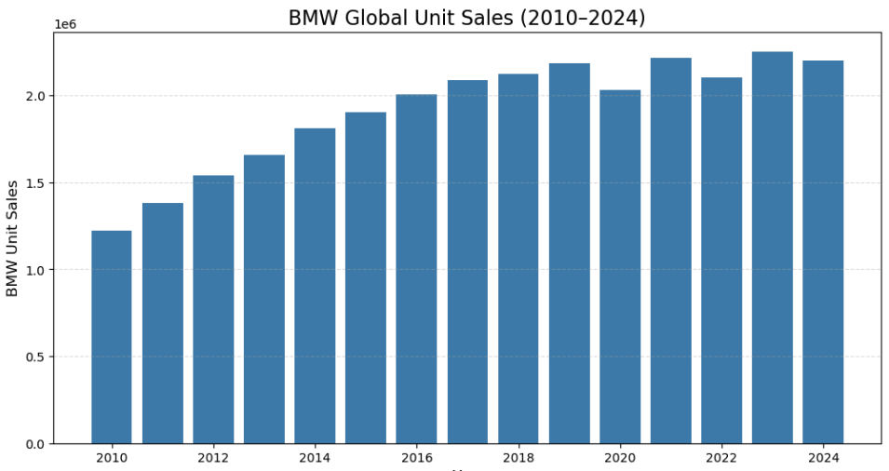
BMW Global Sales Trend (2010–2024)
  Long-term upward trend in global unit sales.
  Short-term fluctuations linked to economic and supply-chain factors.
  Strong sales resilience in recent years.
Notes:
The following chart illustrates how many BMWs were sold around the world from 2010 to 2024. I initially changed the raw data into a structured format and cleaned it up by getting rid of inconsistencies, resolving formatting problems, and so on. This way, the trends could be evaluated accurately. There are short-term dips in the results because of things like economic slowdowns or problems with the supply chain, but overall, the trend is clearly going up over the long term. Overall, BMW is quite strong and has been growing steadily over time.

Slide 7
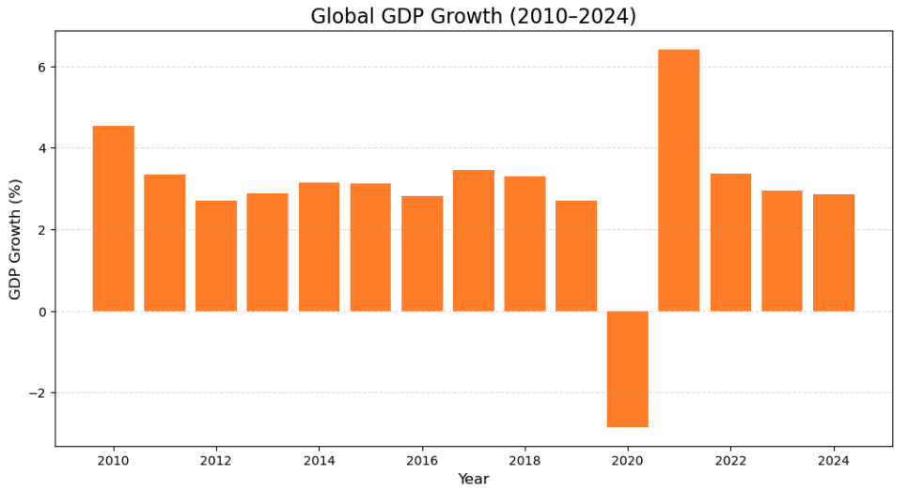
Global GDP Growth Trend (2010–2024)
GDP displays cyclical ups and downs.
Economic slowdowns followed by periods of recovery.
Provides global context for understanding BMW sales performance.
Notes:
This is the growth of the world's GDP over the same time. Before looking at the trends, I also cleaned up and formatted this dataset to make sure the values were correct and consistent. GDP growth changes more quickly than BMW sales, indicating evident economic cycles of slowdowns followed by periods of recovery. This gives us critical background information that will help us understand how outside economic factors might affect BMW's sales.

Slide 8
Data Analysis

Slide 9
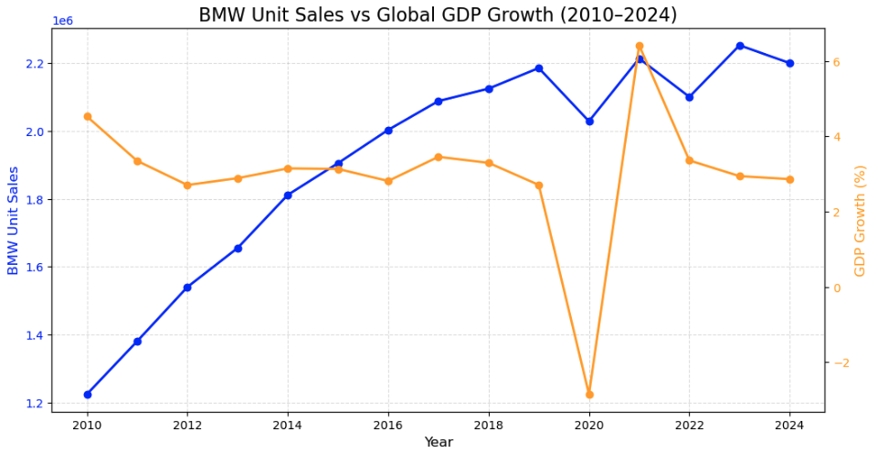
BMW Sales vs. Global GDP Growth
General positive association between economic performance and BMW sales.
Sales show steadier long-term growth than GDP alone.
Brand strategy and product updates also drive sales behavior.
Notes:
This comparison is based on combining the cleaned BMW sales data with the cleaned global GDP data. The combined information reveals that when global GDP goes up, BMW sales usually go up too. This suggests that the two things are related in a good way. But BMW's sales trajectory is smoother and more stable than GDP, which shows that the company's own strategy, brand strength, and product portfolio are also important for long-term growth.

Slide 10


Summary of Trends
BMW sales rise steadily over time.
GDP growth fluctuates but supports overall demand.
Sales increases are more consistent than GDP cycles.
Notes:
To sum up the trends, BMW sales go up gradually over time, GDP growth goes up and down, and even though the economy does affect sales, BMW's long-term upward trajectory is strong and solid.

Slide 11
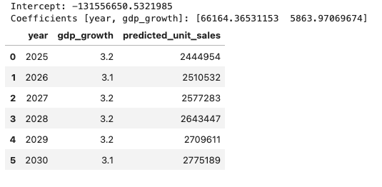
Regression Model & Future Sales Forecast
Model equation summary:
  +66,164 units per year (strong growth trend)
  +5,864 units per 1% GDP growth (moderate effect)
Interpretation:
  Time is the strongest predictor of BMW sales.
  GDP growth contributes but with smaller influence.
Prediction table or sample numbers:
  Forecast: ~2.44M units in 2025 → ~2.78M in 2030 (assuming stable GDP growth).
Notes:
The regression model puts numbers on these relationships. Sales go up by roughly 66,000 units every year, which shows that the company is growing quickly over time. A 1% rise in GDP growth adds about 5,864 units, which is good but not the main reason for the rise. I used this model to predict sales from 2025 to 2030. I think sales will go up from roughly 2.44 million units to 2.78 million units if global growth stays the same.

Slide 12
Challenges

Slide 13

Project Challenges
Data Challenges:
  Inaccurate Kaggle dataset
  Manual extraction from 14+ BMW annual reports
  Cleaning untidy data into a usable structured format
Code Challenges:
  Encoding issues
  Converting year columns
  Merging datasets
  Fixing numeric formatting and NA types
Notes:
I had problems with Kaggle data that wasn't reliable, so I had to manually pull and clean the data from BMW's yearly reports. This was in line with what we learnt this semester about checking data sources and making sure the data is good before analyzing it. When it came to coding, I had to use a lot of the preprocessing techniques we learned in class, like fixing formatting problems, turning disorganized columns into an organized format, merging datasets correctly, and dealing with missing or inconsistent values using coercion and type conversion. These stages made it clear how important data preparation is to the analytics process.

Slide 14

Conclusion
BMW shows strong long-term sales growth.
GDP growth supports sales but is not the main driver.
Regression model confirms upward trend and provides basic forecasts.
Combining company data with economic indicators adds valuable insight.
Notes:
In conclusion, BMW's sales growth over the long run is strong. GDP growth helps this performance, but the company's internal strategy and strong brand identification are the main reasons for it. The regression model backs up the growing trend and gives a simple technique to guess how many sales will happen in the future. Using both corporate data and global economic indicators helped us learn a lot about how well BMW was doing.

Slide 15
References
- Get Icons from this website.
Flaticon
Flaticon. (n.d.). Free icons — Flaticon. Retrieved December 7, 2025, from https://www.flaticon.com/
- Get PowerPoint Templates
Free PowerPoint Templates Design
Free-PowerPoint-Templates-Design.com. (n.d.). Free PowerPoint templates and backgrounds — Free-PowerPoint-Templates-Design.com. Retrieved December 7, 2025, from https://www.free-powerpoint-templates-design.com/

